Slide 1
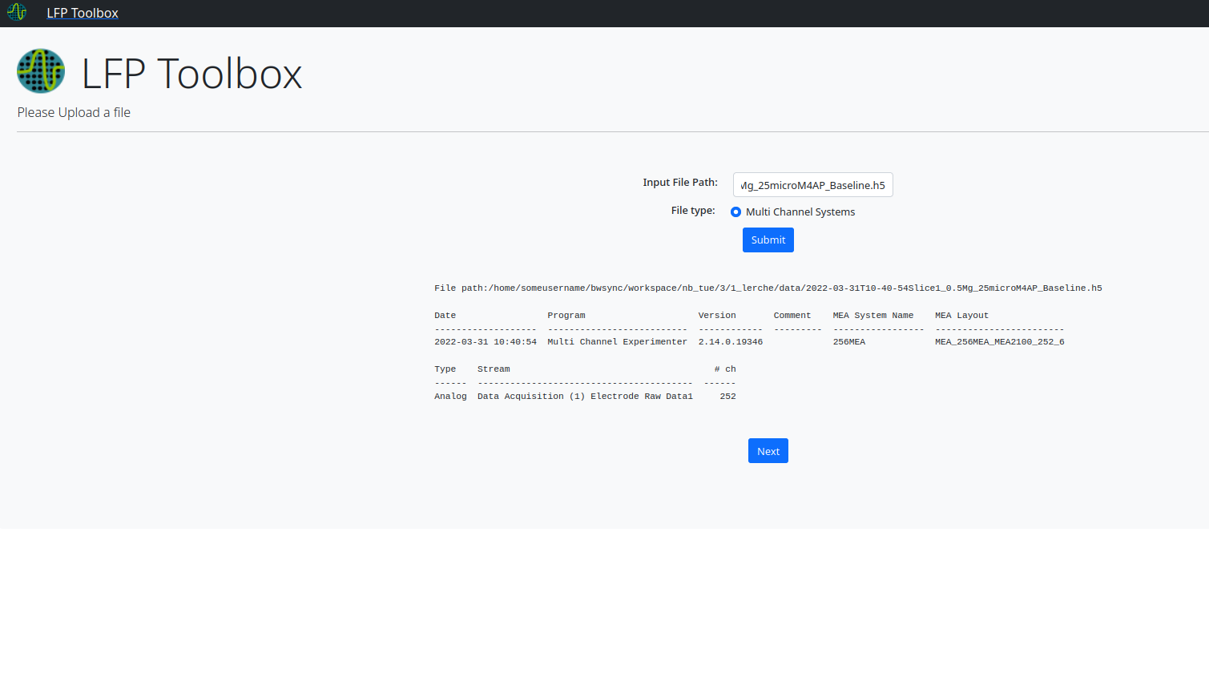
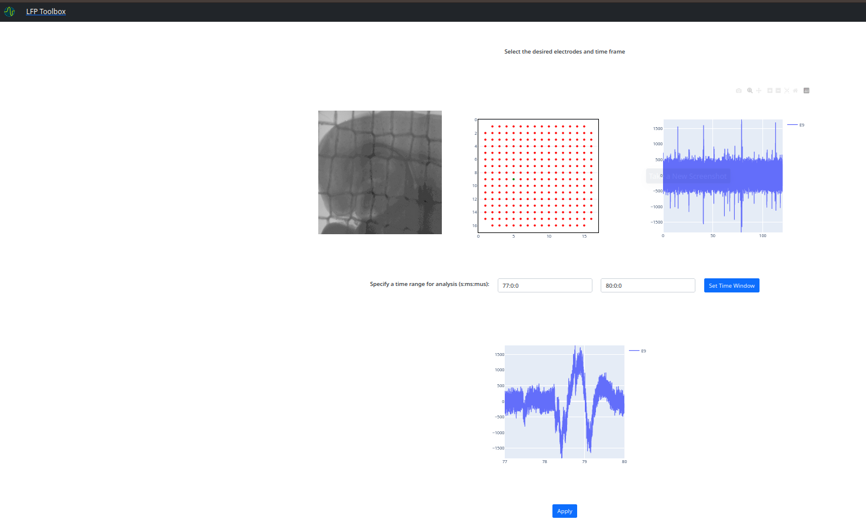
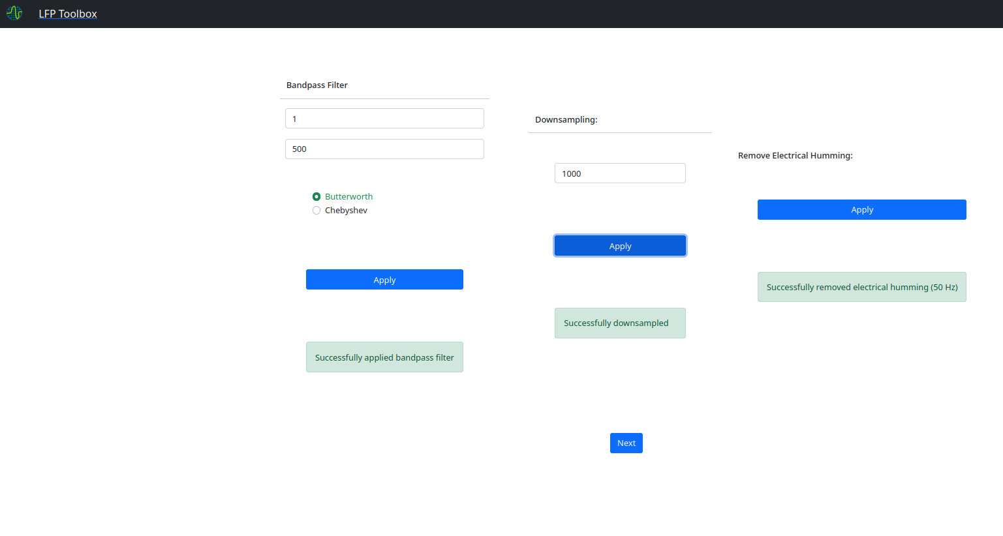
LFP Analysis Toolbox
What’s there so far?
GUI w. Interactive visulaization
Import for MCS 256 MEA (200 μm el. distance)
Select electrodes & time window of interest
Filter electrical humming, bandpass filter, downsample
Amplitude per electrode animation, raw plots
What more should be there in the end?
Exploration & Visualization:
Power (in dB) as animation
Spectrogram/PSD, Periodogram, Envelope
Raster plot, PSTH
Quantitative Analysis:
Periodic-Aperiodic component separation (FOOOF)
FFT, Hilbert T., STFT
Peak & Burst detection
Granger Causality, Cross-correlation,
Electrode Grouping
#Sample reduction for exploration (to incr. Performance)

